Slide 1
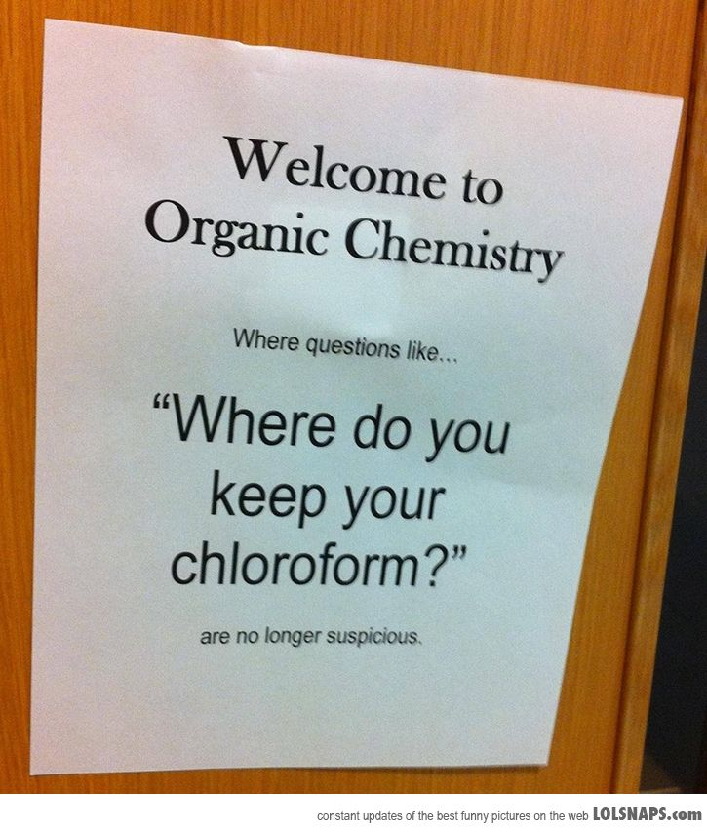

Slide 2
A1 Chemistry
Carbon Chemistry: Alkanes

Slide 3
Write formulae of…
sodium carbonate
copper (II) chloride
zinc nitrate
calcium bromide
ammonium hydroxide
sulfur dioxide

Slide 4
Learning Intentions
hydrocarbons, including alkanes, alkenes and benzene, have different chemical properties that are determined by the nature of the bonding within the molecules
IUPAC nomenclature is used to name straight and simple branched alkanes and alkenes from C1- C8
alkanes, alkenes and benzene undergo characteristic reactions such as combustion, addition reactions for alkenes and substitution reactions for alkanes and benzene

Slide 5
Success criteria
Write general formula for alkanes CnH2n+2
Name alkanes (straight and branched)
Draw alkanes (straight and branched)

Slide 6
Key words
hydrocarbon
alkane
IUPAC
nomenclature

Slide 7
Carbon
The electron configuration of carbon makes it able to bond in infinite number of compounds.

Slide 8
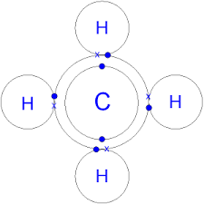
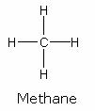
It can form…
Four single bonds

Slide 9
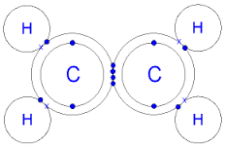
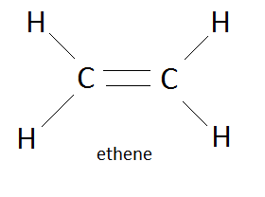
Two single bonds and one double bond

Slide 10
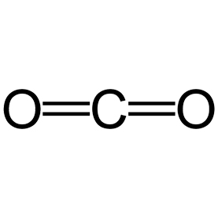
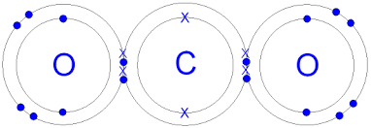
Two double bonds

Slide 11
A triple bond and a single bond

Slide 12
Hydrocarbons
Contain hydrogen and carbon only
Classified according to the type of bonds between carbons
Named according to the length of the longest chain

Slide 13
Nomenclature
Prefix – Suffix
number – type
eg meth-ane

Slide 14
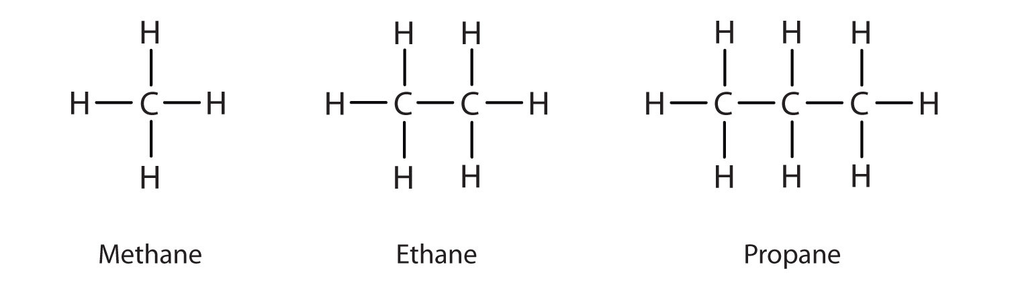
Alkanes
Contain only single bonds between carbon

Slide 15
Longest chain
1 –Meth
2 –Eth
3 –Prop
4 –But
5 –Pent
6 –Hex
7 –Hept
8 –Oct
9 –Non

Slide 16

Side chains
“like alkanes” – alkyl
methyl
ethyl
propyl …
IF there is more than one carbon it could be attached to without making the longest chain longer, use a number to show which carbon the alkyl group is attached to, starting from the end that gives it the lowest number
Use hyphens to separate numbers from letters and commas to separate numbers from each other

Slide 18
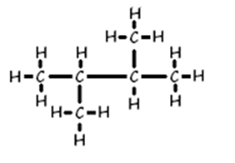
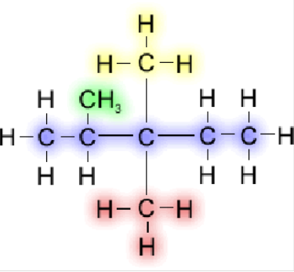
More than one side chain
Prefix of di- tri- tetra- penta- hexa-
indicates how many of each side chain

Slide 19
More than one type of side chain
alphabetical order for both numbering closest end and for listing them, NOT INCLUDING THE NUMBERING PREFIX
ethyl before methyl
methyl before propyl
butyl before ethyl

Slide 20
Success criteria
Write general formula for alkanes CnH2n+2
Name alkanes (straight and branched)
Draw alkanes (straight and branched)

Slide 21
Next time
Alkenes

